Slide 1


Department of BES-1
Data Structures
24SC1203
Topic:
KRUSKAL’S ALGORITHM
Session - 39

Slide 2



AIM OF THE SESSION
To familiarize students with the basic concept of Kruskal’s Algorithm
INSTRUCTIONAL OBJECTIVES
This Session is designed to:
Demonstrate Kruskal’s Algorithm
Describe Minimum Spanning Tree
LEARNING OUTCOMES
At the end of this session, you should be able to:
Define Minimum Spanning Tree
Summarize Kruskal’s Algorithm

Slide 3
SESSION INTRODUCTION
In this session,we discuss about Kruskal's Algorithm, which is a key technique for finding the Minimum Spanning Tree (MST) in a connected, undirected graph. This algorithm uses a greedy approach by selecting edges with the least weight while avoiding cycles. We will explore its working principle, steps, and real-world applications

Slide 4
Kruskal's Algorithm
Kruskal's Algorithm
Kruskal's Algorithm is used to find the minimum spanning tree for a connected weighted graph. The main target of the algorithm is to find the subset of edges by using which we can traverse every vertex of the graph. It follows the greedy approach that finds an optimum solution at every stage instead of focusing on a global optimum.

Slide 5
SESSION DESCRIPTION (Cont..)
Working:
In Kruskal's algorithm, we start from edges with the lowest weight and keep adding the edges until the goal is reached. The steps to implement Kruskal's algorithm are listed as follows -
First, sort all the edges from low weight to high.
Now, take the edge with the lowest weight and add it to the spanning tree. If the edge to be added creates a cycle, then reject the edge.
Continue to add the edges until we reach all vertices, and a minimum spanning tree is created.

Slide 6
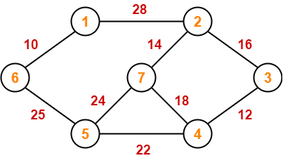
EXAMPLES
The algorithm is a Greedy Algorithm.
The Greedy Choice is to pick the smallest weight edge that does not cause a cycle in the MST constructed so far.
Consider the below input graph.
The graph contains 9 vertices and 14 edges. So, the minimum spanning tree formed will have (9 – 1) = 8 edges.

Slide 7
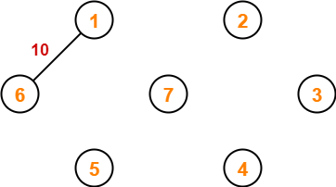
Step 1: Now pick all edges one by one from sorted list of edges
1. Pick edge 6-1: No cycle is formed, include it.
After sorting:
Weight Src Dest
10 6 1
12 4 3
14 2 7
16 2 3
18 5 4
22 8 6
24 5 7
25 6 5
28 1 2

Slide 8
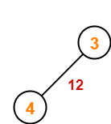
step 2: Now pick edge 4-12. No cycle is formed, hence include it.

Slide 9
step 3: Now pick edge 4-12. No cycle is formed, hence include it.

Slide 10
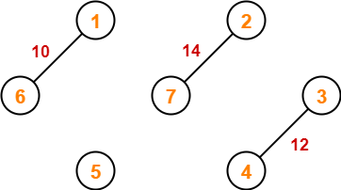
Step 4: Now pick edge 7-2. No cycle is formed, include it.

Slide 11
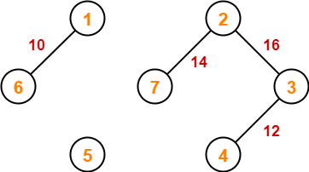
Step 5: Now pick edge 2-3. No cycle is formed, so include it.

Slide 12
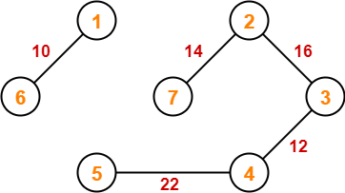
Step 6: Now pick edge 5-4. No cycle is formed, so include it.

Slide 13
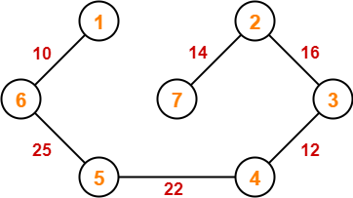
Step 7:Now pick edge 6-5. No cycle is formed, so include it.
Since all the vertices have been connected / included in the MST, so we stop.
Weight of the MST = Sum of all edge weights= 10 + 25 + 22 + 12 + 16 + 14
= 99 units

Slide 14
APPLICATIONS:
Kruskal's algorithm can be used to layout electrical wiring among cities.
It can be used to lay down LAN connections.

Slide 15
SUMMARY
In summary, Kruskal's Algorithm is a greedy method used to find the Minimum Spanning Tree (MST) of a connected, undirected graph. It sorts edges by weight and selects the smallest edges while ensuring no cycles are formed using the Union-Find data structure. The process continues until all vertices are connected with minimum total edge weight. This makes Kruskal's algorithm efficient for edge-centric graph problems.

Slide 16
SELF-ASSESSMENT QUESTIONS
Kruskal’s algorithm is a ______
a) divide and conquer algorithm
b) dynamic programming algorithm
c) greedy algorithm
d) approximation algorithm
2. In Kruskal's algorithm, how are edges processed?
A. From the largest to the smallest weight
B. In arbitrary order
C. From the smallest to the largest weight
D. Based on vertex degree

Slide 17
TERMINAL QUESTIONS
What is the main approach used by Kruskal's algorithm to find the Minimum Spanning Tree (MST)?
In Kruskal's algorithm, how are edges processed?
What is the time complexity of Kruskal's algorithm if edges are sorted using an efficient sorting algorithm?

Slide 18
REFERENCES FOR FURTHER LEARNING OF THE SESSION
Reference Books:
1.
2.
3.
Sites and Web links:
1.
2.
3.
1.A.V.Aho, J. E. Hopcroft, and J. D. Ullman, “Data Structures And Algorithms”, Pearson Education, First Edition Reprint2003.
2.Horowitz, Sahni, Anderson Freed, “Fundamentals of datastructures in C” , Second Edition-2007.
3.R. F. Gilberg, B. A. Forouzan, “Data Structures”, Second Edition, Thomson India Ed ition, 2005.
. https://www.gatevidyalay.com/
2. https://www.simplilearn.com/tutorials/c-tutorial/data-structures-in-c
3.https://www.udemy.com/course/learn-data-structures-using-c-programming-language/

Slide 19
THANK YOU
Team – Data Structures

